Slide 1

Unit 2
College of Computer and Information Sciences
Department of Computer Science
CSC 220: Computer Organization
Digital Logic Gates

Slide 2
Introduction to Digital Logic Basics
Hardware consists of a few simple building blocks
  These are called logic gates
    AND, OR, NOT, …
    NAND, NOR, XOR, …
Logic gates are built using transistors
    NOT gate can be implemented by a single transistor
    AND gate requires 3 transistors
Transistors are the fundamental devices
    Pentium consists of 3 million transistors
    Compaq Alpha consists of 9 million transistors
    Now we can build chips with more than 100 million transistors

Slide 3
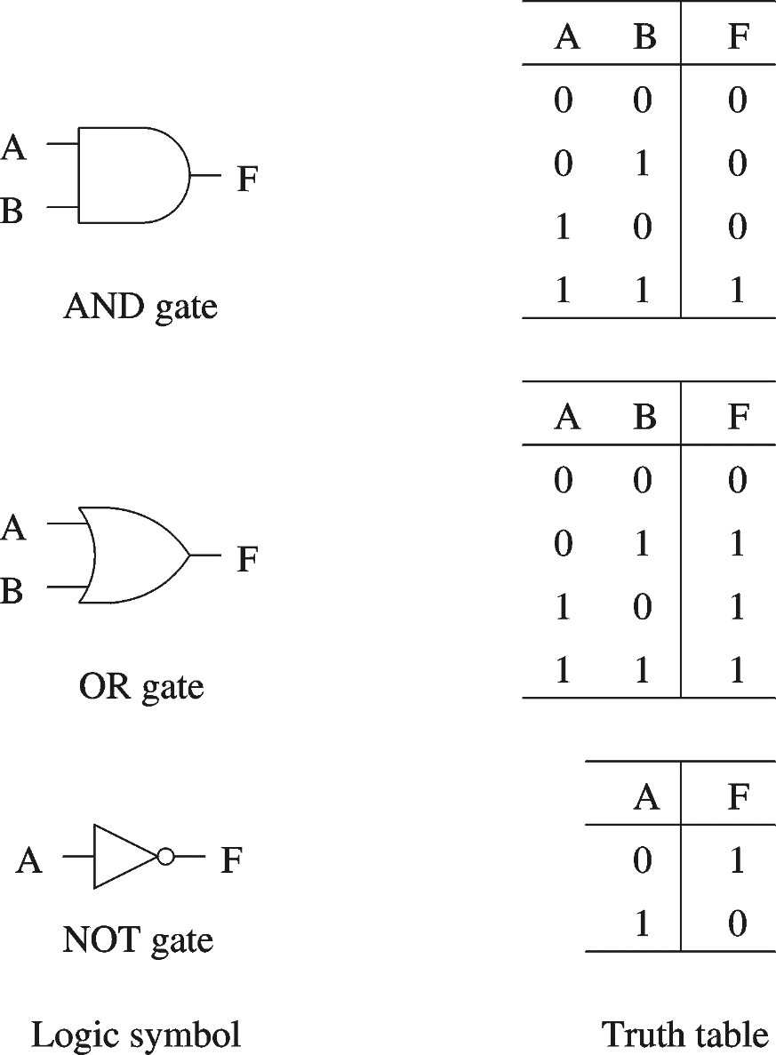
Basic Concepts
Simple gates
  AND
  OR
  NOT
Functionality can be expressed by a truth table
  A truth table lists output for each possible input combination
Precedence
  NOT > AND > OR
  F = A B + A B
  = (A (B)) + ((A) B)

Slide 4
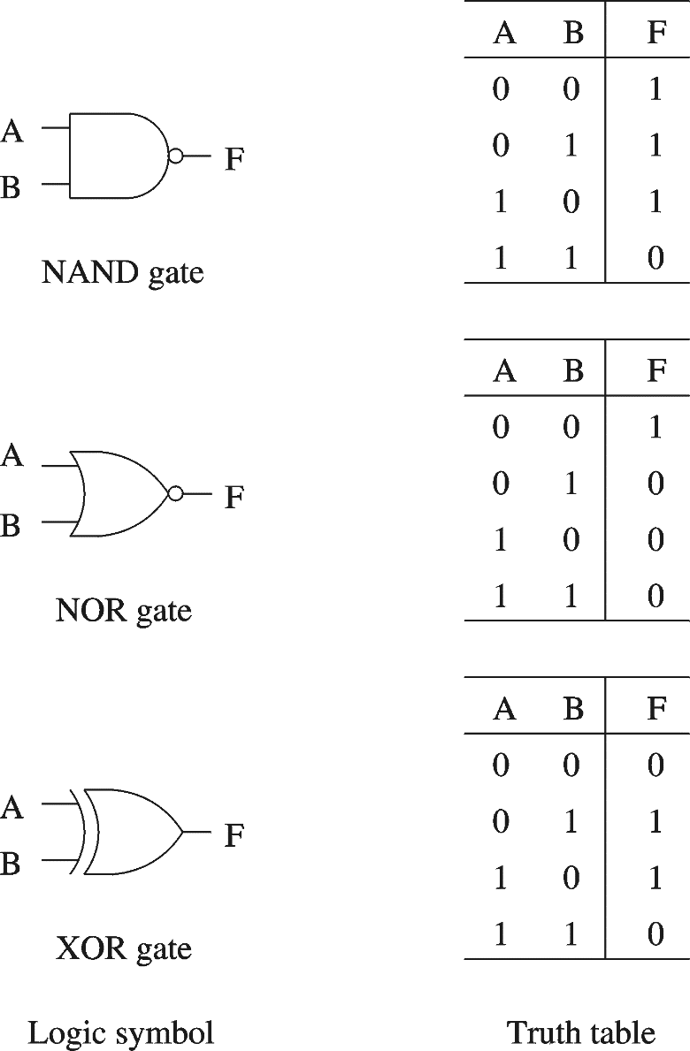
Basic Concepts (cont.)
Additional useful gates
  NAND
  NOR
  XOR
NAND = AND + NOT
NOR = OR + NOT
XOR implements exclusive-OR function
NAND and NOR gates require only 2 transistors
  AND and OR need 3 transistors!

Slide 5
Basic Concepts (cont.)
Complete sets
  A set of gates is complete
    If we can implement any logical function using only the type of gates in the set
      You can uses as many gates as you want
  Some example complete sets
    {AND, OR, NOT} Not a minimal complete set
    {AND, NOT}
    {OR, NOT}
    {NAND}
    {NOR}
  Minimal complete set
      A complete set with no redundant elements.

Slide 6
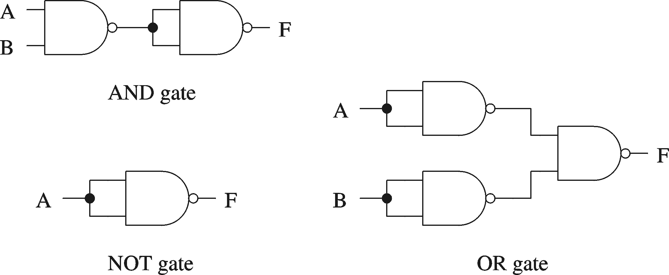
Basic Concepts (cont.)
Proving NAND gate is universal

Slide 7
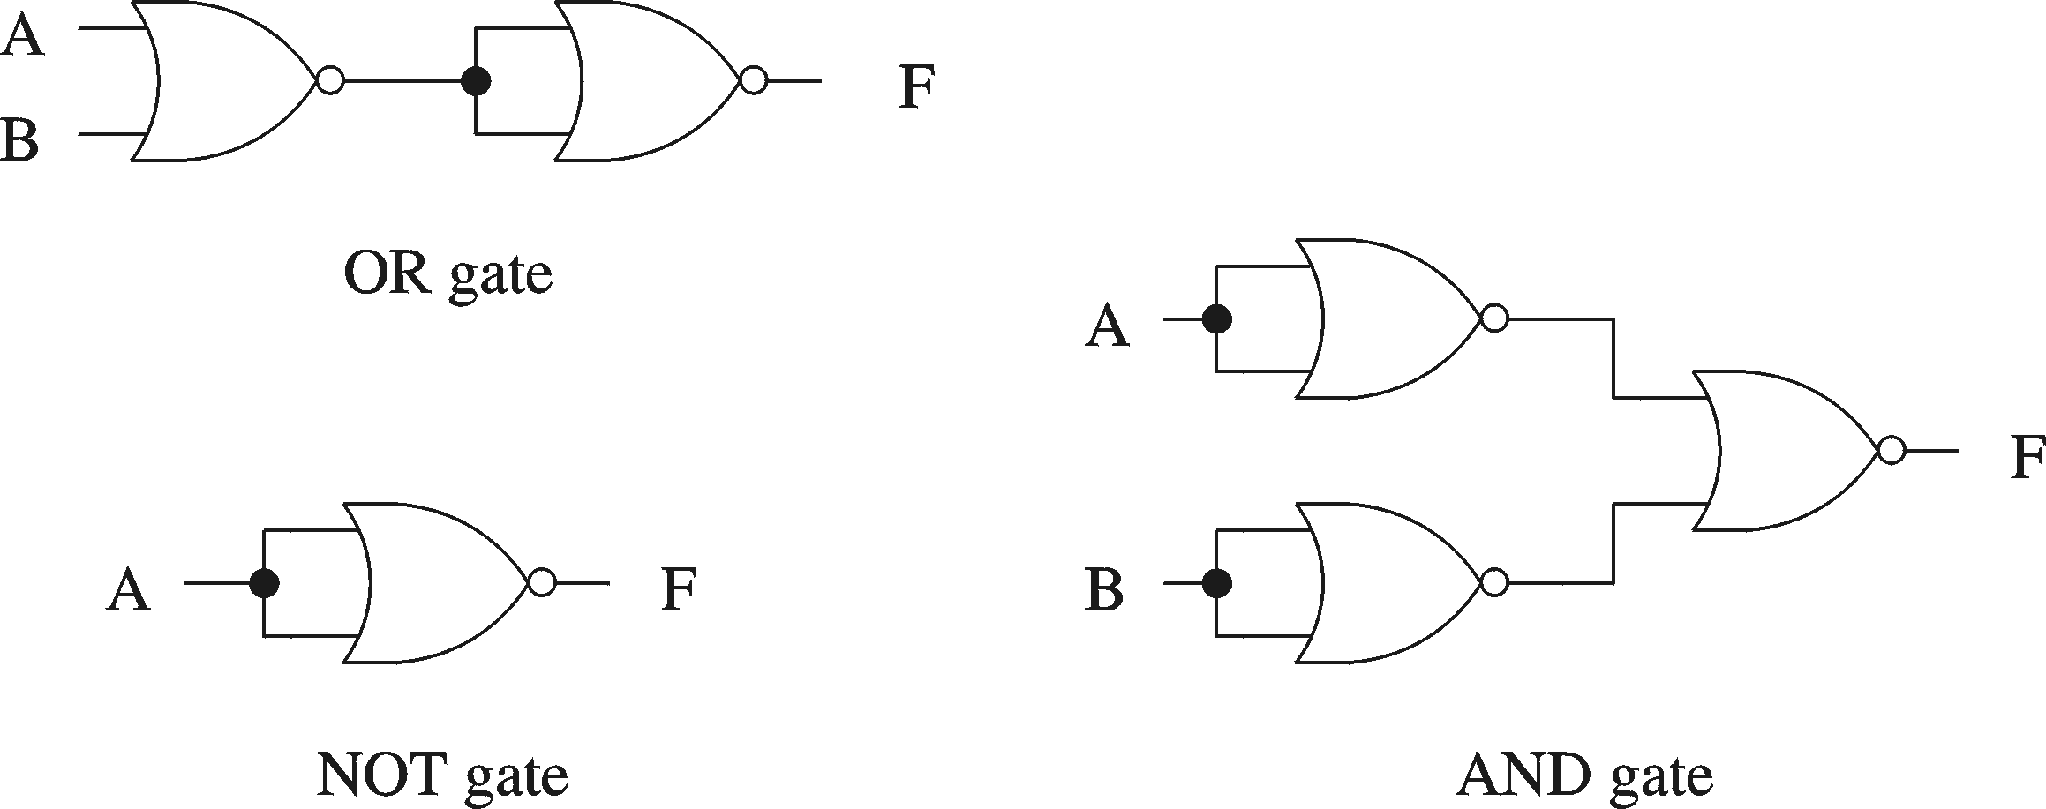
Basic Concepts (cont.)
Proving NOR gate is universal

Slide 8
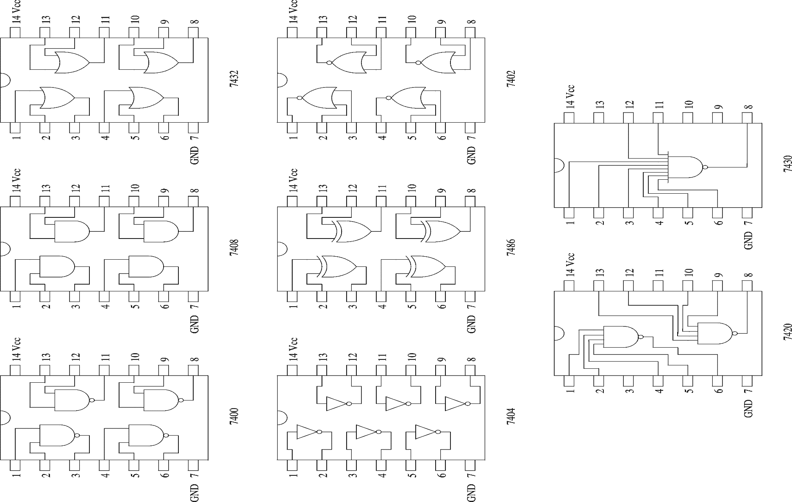
Logic Chips (cont.)

Slide 9
Logic Chips (cont.)
Integration levels
  SSI (small scale integration)
    Introduced in late 1960s
    1-10 gates (previous examples)
  MSI (medium scale integration)
    Introduced in late 1960s
    10-100 gates
  LSI (large scale integration)
    Introduced in early 1970s
    100-10,000 gates
  VLSI (very large scale integration)
    Introduced in late 1970s
    More than 10,000 gates

Slide 10
Chapter 1: continue
Applications of XOR and XNOR Gates
Prof. Laxmikant Kale - university of illinois at urbana-champaign - Computer Sciences

Slide 11

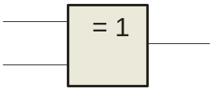
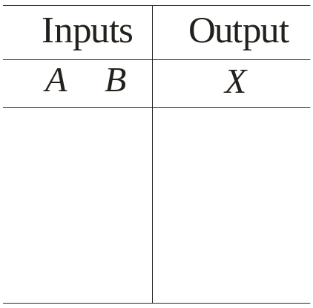
The XOR Gate
A
X
A
X
B
B
The XOR gate produces a HIGH output only when the inputs are at opposite logic levels. The truth table is
0 0
0 1
1 0
1 1
0
1
1
0
The XOR operation is written as X = AB + AB. Alternatively, it can be written with a circled plus sign between the variables as X = A + B.
Notes:
-XOR gate has only two inputs.

Slide 12
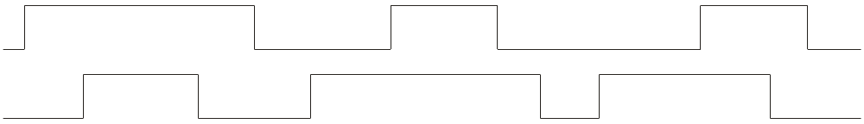
The XOR Gate
A
X
A
X
B
B
Example waveforms:
A
B
X
Notice that the XOR gate will produce a HIGH only when exactly one input is HIGH.

Slide 13

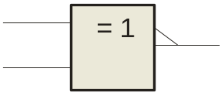
The XNOR Gate
A
X
A
X
B
B
The XNOR gate produces a HIGH output only when the inputs are at the same logic level. The truth table is
0 0
0 1
1 0
1 1
1
0
0
1
The XNOR operation can be shown as X = AB + AB.
Notes:
-XNOR gate has only two inputs.

Slide 14
The XNOR Gate
A
X
A
X
B
B
Example waveforms:
A
B
X
Notice that the XNOR gate will produce a HIGH when both inputs are the same. This makes it useful for comparison functions.

Slide 15
Applications of XOR and XNOR Gates
Three common applications:
  Comparators
  Parity generation and checking

Slide 16
Comparator
A comparator compares two string of bits to see whether they are equal to each other:
  Example: if string A = 0101 and string B = 0100, then A≠ B.
Next slide shows how to build a 4-bit comparator from XNOR gates.

Slide 17
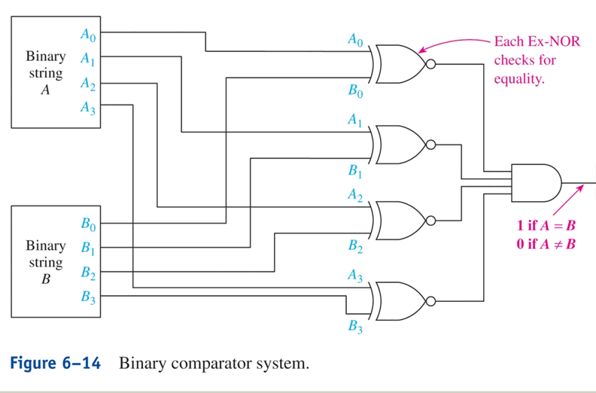
Comparator Circuit

Slide 18

Parity Checking
Parity checking is a method of error detection for simple transmission errors involving one bit (or an odd number of bits). A parity bit is an “extra” bit attached to a group of bits to force the number of 1’s to be either even (even parity) or odd (odd parity).
Example
The ASCII character for “a” is 1100001 and for “A” is 1000001. What is the correct bit to append to make both of these have odd parity?
Solution
The ASCII “a” has an odd number of bits that are equal to 1; therefore the parity bit is 0. The ASCII “A” has an even number of bits that are equal to 1; therefore the parity bit is 1.

Slide 19
Parity Generators
To implement parity checking, we need circuitry on the sending end that generates the parity bit for each group of bits being sent. This circuitry is called a parity generator.
Next slide shows how to build 4-bit even or odd parity generators.

Slide 20
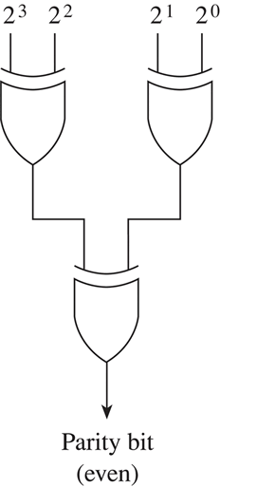
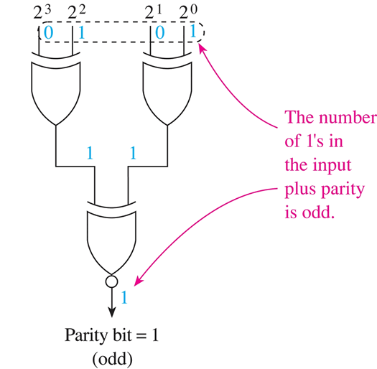
Parity Generators (Book’s Fig. 6-9)

Slide 21
Parity Checkers
On the receiving end, we need circuitry that checks the data bits and parity bit as they’re received to decide whether an error has occurred during transmission. This circuitry is called a parity checker.
Next slide shows how to build a 4-bit-plus-parity even parity checker.

Slide 22
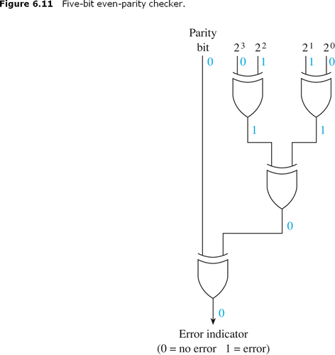
Parity Checker

Slide 23
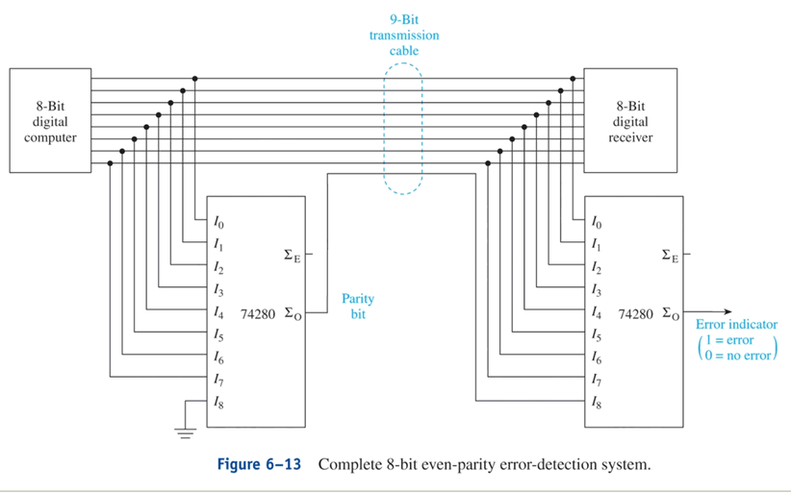
Parity System

